Slide 1
UNIT-5 NLP
Dr. SONAM MITTAL
Associate Professor
IT Dept. BKBIET- Pilani

Slide 2
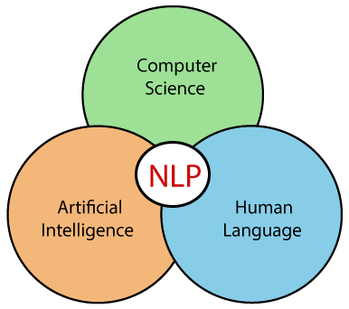
What is NLP?
NLP stands for Natural Language Processing, which is a part of Computer Science, Human language, and Artificial Intelligence.
It is the technology that is used by machines to understand, analyse, manipulate, and interpret human's languages.
It helps developers to organize knowledge for performing tasks such as translation, automatic summarization, Named Entity Recognition (NER), speech recognition, relationship extraction, and topic segmentation.

Slide 3
History of NLP
(1940-1960) - Focused on Machine Translation (MT):The Natural Languages Processing started in the year 1940s.
1948 - In the Year 1948, the first recognisable NLP application was introduced in Birkbeck College, London.
1950s - In the Year 1950s, there was a conflicting view between linguistics and computer science. Now, Chomsky developed his first book syntactic structures and claimed that language is generative in nature.
In 1957, Chomsky also introduced the idea of Generative Grammar, which is rule based descriptions of syntactic structures.
(1960-1980) - Flavored with Artificial Intelligence (AI)

Slide 4
In the year 1960 to 1980, the key developments were:
Augmented Transition Networks (ATN)
Augmented Transition Networks is a finite state machine that is capable of recognizing regular languages.
Case Grammar
Case Grammar was developed by Linguist Charles J. Fillmore in the year 1968. Case Grammar uses languages such as English to express the relationship between nouns and verbs by using the preposition.
In Case Grammar, case roles can be defined to link certain kinds of verbs and objects.
For example: "Neha broke the mirror with the hammer". In this example case grammar identify Neha as an agent, mirror as a theme, and hammer as an instrument.

Slide 5
In the year 1960 to 1980, key systems were:
SHRDLU
SHRDLU is a program written by Terry Winograd in 1968-70.
It helps users to communicate with the computer and moving objects. It can handle instructions such as "pick up the green boll" and also answer the questions like "What is inside the black box."
The main importance of SHRDLU is that it shows those syntax, semantics, and reasoning about the world that can be combined to produce a system that understands a natural language.
LUNAR
LUNAR is the classic example of a Natural Language database interface system that is used ATNs and Woods' Procedural Semantics.
It was capable of translating elaborate natural language expressions into database queries and handle 78% of requests without errors.

Slide 6
1980 - Current
Till the year 1980, natural language processing systems were based on complex sets of hand-written rules.
After 1980, NLP introduced machine learning algorithms for language processing.
In the beginning of the year 1990s, NLP started growing faster and achieved good process accuracy, especially in English Grammar.
In 1990 also, an electronic text introduced, which provided a good resource for training and examining natural language programs.
Other factors may include the availability of computers with fast CPUs and more memory. The major factor behind the advancement of natural language processing was the Internet.
Now, modern NLP consists of various applications, like speech recognition, machine translation, and machine text reading.
When we combine all these applications then it allows the artificial intelligence to gain knowledge of the world.
Let's consider the example of AMAZON ALEXA, using this robot you can ask the question to Alexa, and it will reply to you.

Slide 7
Advantages of NLP
NLP helps users to ask questions about any subject and get a direct response within seconds.
NLP offers exact answers to the question means it does not offer unnecessary and unwanted information.
NLP helps computers to communicate with humans in their languages.
It is very time efficient.
Most of the companies use NLP to improve the efficiency of documentation processes, accuracy of documentation, and identify the information from large databases.

Slide 8
Disadvantages of NLP
A list of disadvantages of NLP is given below:
NLP may not show context.
NLP is unpredictable
NLP may require more keystrokes.
NLP is unable to adapt to the new domain, and it has a limited function that's why NLP is built for a single and specific task only.

Slide 9
Components of NLP
There are the following two components of NLP –
1. Natural Language Understanding (NLU)
Natural Language Understanding (NLU) helps the machine to understand and analyse human language by extracting the metadata from content such as concepts, entities, keywords, emotion, relations, and semantic roles.
NLU mainly used in Business applications to understand the customer's problem in both spoken and written language.
NLU involves the following tasks -
It is used to map the given input into useful representation.
It is used to analyze different aspects of the language.

Slide 10
2. Natural Language Generation (NLG)
Natural Language Generation (NLG) acts as a translator that converts the computerized data into natural language representation.
It mainly involves Text planning, Sentence planning, and Text Realization.
Difference between NLU and NLG
NLU | NLG
NLU is the process of reading and interpreting language. | NLG is the process of writing or generating language.
It produces non-linguistic outputs from natural language inputs. | It produces constructing natural language outputs from non-linguistic inputs.
The NLU is difficult than NLG.

Slide 11
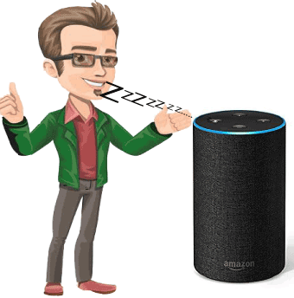
Applications of NLP
There are the following applications of NLP –
1. Question Answering
Question Answering focuses on building systems that automatically answer the questions asked by humans in a natural language.

Slide 12
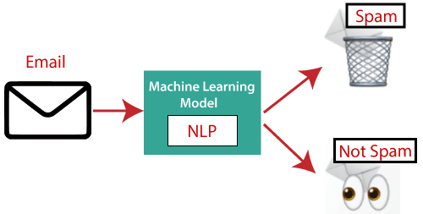
2. Spam Detection
Spam detection is used to detect unwanted e-mails getting to a user's inbox.

Slide 13

3. Sentiment Analysis
Sentiment Analysis is also known as opinion mining.
It is used on the web to analyse the attitude, behaviour, and emotional state of the sender.
This application is implemented through a combination of NLP (Natural Language Processing) and statistics by assigning the values to the text (positive, negative, or natural), identify the mood of the context (happy, sad, angry, etc.)

Slide 14
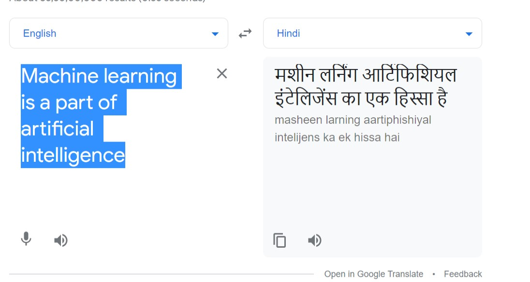
4. Machine Translation
Machine translation is used to translate text or speech from one natural language to another natural language.
Example: Google Translator

Slide 15
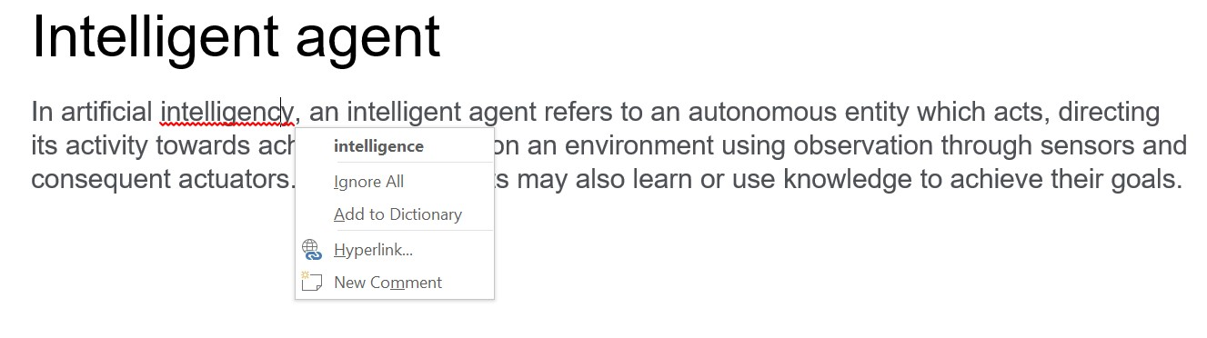
5. Spelling correction
Microsoft Corporation provides word processor software like MS-word, PowerPoint for the spelling correction.

Slide 16
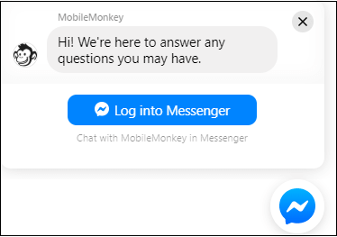
6. Speech Recognition
Speech recognition is used for converting spoken words into text. It is used in applications, such as mobile, home automation, video recovery, dictating to Microsoft Word, voice biometrics, voice user interface, and so on.
7. Chatbot
Implementing the Chatbot is one of the important applications of NLP. It is used by many companies to provide the customer's chat services.

Slide 17
8. Information extraction
Information extraction is one of the most important applications of NLP. It is used for extracting structured information from unstructured or semi-structured machine-readable documents.
9. Natural Language Understanding (NLU)
It converts a large set of text into more formal representations such as first-order logic structures that are easier for the computer programs to manipulate notations of the natural language processing.

Slide 18
How to build an NLP pipeline
There are the following steps to build an NLP pipeline -
Step1: Sentence Segmentation
Sentence Segment is the first step for building the NLP pipeline. It breaks the paragraph into separate sentences.
Example: Consider the following paragraph -
Independence Day is one of the important festivals for every Indian citizen. It is celebrated on the 15th of August each year ever since India got independence from the British rule. This day celebrates independence in the true sense.
Sentence Segment produces the following result:
"Independence Day is one of the important festivals for every Indian citizen."
"It is celebrated on the 15th of August each year ever since India got independence from the British rule."
"This day celebrates independence in the true sense."

Slide 19
Step2: Word Tokenization
Word Tokenizer is used to break the sentence into separate words or tokens.
Example:
JavaTpoint offers Corporate Training, Summer Training, Online Training, and Winter Training.
Word Tokenizer generates the following result:
"JavaTpoint", "offers", "Corporate", "Training", "Summer", "Training", "Online", "Training", "and", "Winter", "Training", "."

Slide 20
Step3: Stemming
Stemming is used to normalize words into its base form or root form.
For example, celebrates, celebrated and celebrating, all these words are originated with a single root word "celebrate."
The big problem with stemming is that sometimes it produces the root word which may not have any meaning.
For Example, intelligence, intelligent, and intelligently, all these words are originated with a single root word "intelligen." In English, the word "intelligen" do not have any meaning.

Slide 21
Step 4: Lemmatization
Lemmatization is quite similar to the Stamming. It is used to group different inflected forms of the word, called Lemma.
The main difference between Stemming and lemmatization is that it produces the root word, which has a meaning.
For example: In lemmatization, the words intelligence, intelligent, and intelligently has a root word intelligent, which has a meaning.

Slide 22
Step 5: Identifying Stop Words
In English, there are a lot of words that appear very frequently like "is", "and", "the", and "a". NLP pipelines will flag these words as stop words. Stop words might be filtered out before doing any statistical analysis.
Example: He is a good boy.
Step 6: Dependency Parsing
Dependency Parsing is used to find that how all the words in the sentence are related to each other.

Slide 23
Step 7: POS tags
POS stands for parts of speech, which includes Noun, verb, adverb, and Adjective.
It indicates that how a word functions with its meaning as well as grammatically within the sentences.
A word has one or more parts of speech based on the context in which it is used.
Example: "Google" something on the Internet.
In the above example, Google is used as a verb, although it is a proper noun.

Slide 24
Step 8: Named Entity Recognition (NER)
Named Entity Recognition (NER) is the process of detecting the named entity such as person name, movie name, organization name, or location.
Example: Steve Jobs introduced iPhone at the Macworld Conference in San Francisco, California.
Step 9: Chunking
Chunking is used to collect the individual piece of information and grouping them into bigger pieces of sentences.

Slide 25
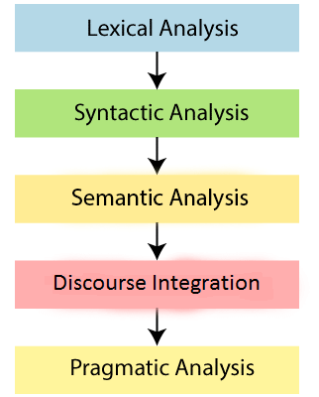
Phases of NLP
There are the following five phases of NLP:

Slide 26
Lexical Analysis and Morphological
The first phase of NLP is the Lexical Analysis.
This phase scans the source code as a stream of characters and converts it into meaningful lexemes.
It divides the whole text into paragraphs, sentences, and words.
2. Syntactic Analysis (Parsing)
Syntactic Analysis is used to check grammar, word arrangements, and shows the relationship among the words.
Example: Agra goes to the Poonam
In the real world, Agra goes to the Poonam, does not make any sense, so this sentence is rejected by the Syntactic analyzer.

Slide 27
3. Semantic Analysis
Semantic analysis is concerned with the meaning representation. It mainly focuses on the literal meaning of words, phrases, and sentences.
4. Discourse Integration
Discourse Integration depends upon the sentences that proceeds it and also invokes the meaning of the sentences that follow it.
5. Pragmatic Analysis
Pragmatic is the fifth and last phase of NLP. It helps you to discover the intended effect by applying a set of rules that characterize cooperative dialogues.
For Example: "Open the door" is interpreted as a request instead of an order.

Slide 28
Why NLP is difficult?
NLP is difficult because Ambiguity and Uncertainty exist in the language.
Ambiguity
There are the following three ambiguity -
1. Lexical Ambiguity
Lexical Ambiguity exists in the presence of two or more possible meanings of the sentence within a single word.
Example:
Manya is looking for a match.
In the above example, the word match refers to that either Manya is looking for a partner or Manya is looking for a match. (Cricket or other match)

Slide 29
2. Syntactic Ambiguity
Syntactic Ambiguity exists in the presence of two or more possible meanings within the sentence.
Example:
I saw the girl with the binocular.
In the above example, did I have the binoculars? Or did the girl have the binoculars?
3. Referential Ambiguity
Referential Ambiguity exists when you are referring to something using the pronoun.
Example: Kiran went to Sunita. She said, "I am hungry."
In the above sentence, you do not know that who is hungry, either Kiran or Sunita.

Slide 30
NLP APIs
Natural Language Processing APIs allow developers to integrate human-to-machine communications and complete several useful tasks such as speech recognition, chatbots, spelling correction, sentiment analysis, etc.
A list of NLP APIs is given below:
IBM Watson API
IBM Watson API combines different sophisticated machine learning techniques to enable developers to classify text into various custom categories.
It supports multiple languages, such as English, French, Spanish, German, Chinese, etc.
With the help of IBM Watson API, you can extract insights from texts, add automation in workflows, enhance search, and understand the sentiment. The main advantage of this API is that it is very easy to use. Pricing: Firstly, it offers a free 30 days trial IBM cloud account. You can also opt for its paid plans.

Slide 31
Chatbot API
Chatbot API allows you to create intelligent chatbots for any service.
It supports Unicode characters, classifies text, multiple languages, etc.
It is very easy to use. It helps you to create a chatbot for your web applications.
Pricing: Chatbot API is free for 150 requests per month. You can also opt for its paid version, which starts from $100 to $5,000 per month.
Speech to text API
Speech to text API is used to convert speech to text Pricing: Speech to text API is free for converting 60 minutes per month. Its paid version starts form $500 to $1,500 per month.

Slide 32
Sentiment Analysis API
Sentiment Analysis API is also called as 'opinion mining' which is used to identify the tone of a user (positive, negative, or neutral) Pricing: Sentiment Analysis API is free for less than 500 requests per month. Its paid version starts form $19 to $99 per month.
Translation API by SYSTRAN
The Translation API by SYSTRAN is used to translate the text from the source language to the target language. You can use its NLP APIs for language detection, text segmentation, named entity recognition, tokenization, and many other tasks. Pricing: This API is available for free. But for commercial users, you need to use its paid version.

Slide 33
Text Analysis API by AYLIEN
Text Analysis API by AYLIEN is used to derive meaning and insights from the textual content. It is available for both free as well as paid from$119 per month. It is easy to use. Pricing: This API is available free for 1,000 hits per day. You can also use its paid version, which starts from $199 to S1, 399 per month.
Cloud NLP API
The Cloud NLP API is used to improve the capabilities of the application using natural language processing technology. It allows you to carry various natural language processing functions like sentiment analysis and language detection. It is easy to use. Pricing: Cloud NLP API is available for free.

Slide 34
Google Cloud Natural Language API
Google Cloud Natural Language API allows you to extract beneficial insights from unstructured text.
This API allows you to perform entity recognition, sentiment analysis, content classification, and syntax analysis in more the 700 predefined categories.
It also allows you to perform text analysis in multiple languages such as English, French, Chinese, and German.
Pricing: After performing entity analysis for 5,000 to 10,000,000 units, you need to pay $1.00 per 1000 units per month.

Slide 35
NLP Libraries
Scikit-learn: It provides a wide range of algorithms for building machine learning models in Python.
Natural language Toolkit (NLTK): NLTK is a complete toolkit for all NLP techniques.
Pattern: It is a web mining module for NLP and machine learning.
TextBlob: It provides an easy interface to learn basic NLP tasks like sentiment analysis, noun phrase extraction, or pos-tagging.
Quepy: Quepy is used to transform natural language questions into queries in a database query language.
SpaCy: SpaCy is an open-source NLP library which is used for Data Extraction, Data Analysis, Sentiment Analysis, and Text Summarization.
Gensim: Gensim works with large datasets and processes data streams.

Slide 36
Difference between Natural language and Computer Language
Natural Language | Computer Language
Natural language has a very large vocabulary. | Computer language has a very limited vocabulary.
Natural language is easily understood by humans. | Computer language is easily understood by the machines.
Natural language is ambiguous in nature. | Computer language is unambiguous.

Slide 37
Expert System

Slide 38
What is an Expert System?
An expert system is a computer program that is designed to solve complex problems and to provide decision-making ability like a human expert.
It performs this by extracting knowledge from its knowledge base using the reasoning and inference rules according to the user queries.
The expert system is a part of AI, and the first ES was developed in the year 1970, which was the first successful approach of artificial intelligence.
It solves the most complex issue as an expert by extracting the knowledge stored in its knowledge base.

Slide 39
The system helps in decision making for complex problems using both facts and heuristics like a human expert.
It is called so because it contains the expert knowledge of a specific domain and can solve any complex problem of that particular domain.
These systems are designed for a specific domain, such as medicine, science, etc.
The performance of an expert system is based on the expert's knowledge stored in its knowledge base.
The more knowledge stored in the KB, the more that system improves its performance.
One of the common examples of an ES is a suggestion of spelling errors while typing in the Google search box.

Slide 40
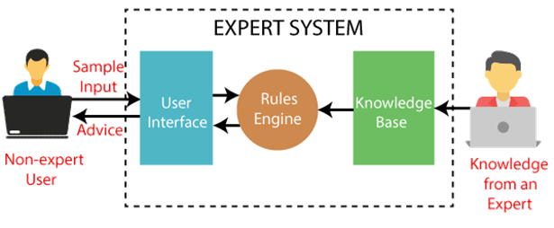
Below is the block diagram that represents the working of an expert system:
It is important to remember that an expert system is not used to replace the human experts; instead, it is used to assist the human in making a complex decision.
These systems do not have human capabilities of thinking and work on the basis of the knowledge base of the particular domain.

Slide 41
Below are some popular examples of the Expert System:
DENDRAL:
It was an artificial intelligence project that was made as a chemical analysis expert system.
It was used in organic chemistry to detect unknown organic molecules with the help of their mass spectra and knowledge base of chemistry.
MYCIN:
It was one of the earliest backward chaining expert systems that was designed to find the bacteria causing infections like bacteraemia and meningitis.
It was also used for the recommendation of antibiotics and the diagnosis of blood clotting diseases.

Slide 42
PXDES:
It is an expert system that is used to determine the type and level of lung cancer.
To determine the disease, it takes a picture from the upper body, which looks like the shadow.
This shadow identifies the type and degree of harm.
CaDeT:
The CaDet expert system is a diagnostic support system that can detect cancer at early stages.

Slide 43
Characteristics of Expert System
High Performance: The expert system provides high performance for solving any type of complex problem of a specific domain with high efficiency and accuracy.
Understandable: It responds in a way that can be easily understandable by the user. It can take input in human language and provides the output in the same way.
Reliable: It is much reliable for generating an efficient and accurate output.
Highly responsive: ES provides the result for any complex query within a very short period of time.

Slide 44
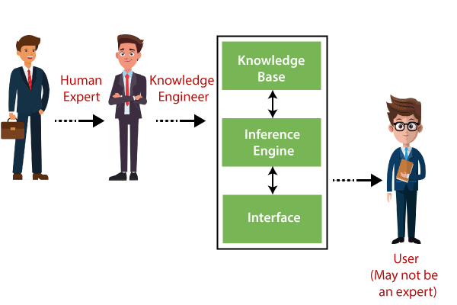
Components of Expert System
An expert system mainly consists of three components:
User Interface
Inference Engine
Knowledge Base

Slide 45
1. User Interface
With the help of a user interface, the expert system interacts with the user, takes queries as an input in a readable format, and passes it to the inference engine.
After getting the response from the inference engine, it displays the output to the user.
In other words, it is an interface that helps a non-expert user to communicate with the expert system to find a solution.

Slide 46
2. Inference Engine(Rules of Engine)
The inference engine is known as the brain of the expert system as it is the main processing unit of the system.
It applies inference rules to the knowledge base to derive a conclusion or deduce new information.
It helps in deriving an error-free solution of queries asked by the user.
With the help of an inference engine, the system extracts the knowledge from the knowledge base.

Slide 47
There are two types of inference engine:
Deterministic Inference engine: The conclusions drawn from this type of inference engine are assumed to be true. It is based on facts and rules.
Probabilistic Inference engine: This type of inference engine contains uncertainty in conclusions, and based on the probability.

Slide 48
Inference engine uses the below modes to derive the solutions:
Forward Chaining: It starts from the known facts and rules, and applies the inference rules to add their conclusion to the known facts.
Backward Chaining: It is a backward reasoning method that starts from the goal and works backward to prove the known facts.

Slide 49
3. Knowledge Base
The knowledgebase is a type of storage that stores knowledge acquired from the different experts of the particular domain.
It is considered as big storage of knowledge. The more the knowledge base, the more precise will be the Expert System.
It is similar to a database that contains information and rules of a particular domain or subject.
One can also view the knowledge base as collections of objects and their attributes. Such as a Lion is an object and its attributes are it is a mammal, it is not a domestic animal, etc.

Slide 50
Components of Knowledge Base
Factual Knowledge:
The knowledge which is based on facts and accepted by knowledge engineers comes under factual knowledge.
Heuristic Knowledge:
This knowledge is based on practice, the ability to guess, evaluation, and experiences.
Knowledge Representation:
It is used to formalize the knowledge stored in the knowledge base using the If-else rules.
Knowledge Acquisitions:
It is the process of extracting, organizing, and structuring the domain knowledge, specifying the rules to acquire the knowledge from various experts, and store that knowledge into the knowledge base.

Slide 51
Development of Expert System
The working of an expert system by taking an example of MYCIN ES. Below are some steps to build an MYCIN:
Firstly, ES should be fed with expert knowledge.
In the case of MYCIN, human experts specialized in the medical field of bacterial infection, provide information about the causes, symptoms, and other knowledge in that domain.
The KB of the MYCIN is updated successfully.

Slide 52
In order to test it, the doctor provides a new problem to it. The problem is to identify the presence of the bacteria by inputting the details of a patient, including the symptoms, current condition, and medical history.
The ES will need a questionnaire to be filled by the patient to know the general information about the patient, such as gender, age, etc.
Now the system has collected all the information, so it will find the solution for the problem by applying if-then rules using the inference engine and using the facts stored within the KB.
In the end, it will provide a response to the patient by using the user interface.

Slide 53
Participants in the development of Expert System
There are three primary participants in the building of Expert System:
Expert: The success of an ES much depends on the knowledge provided by human experts. These experts are those persons who are specialized in that specific domain.
Knowledge Engineer: Knowledge engineer is the person who gathers the knowledge from the domain experts and then codifies that knowledge to the system according to the formalism.
End-User: This is a particular person or a group of people who may not be experts, and working on the expert system needs the solution or advice for his queries, which are complex.

Slide 54
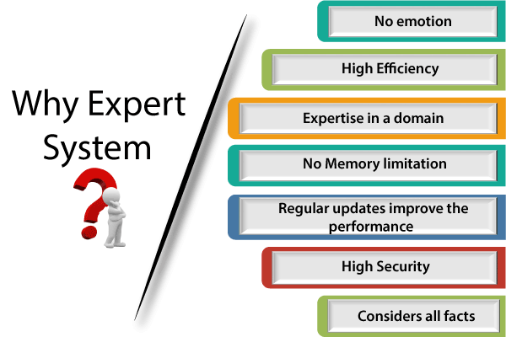
Why Expert System?

Slide 55
Need of the ES:
No memory Limitations: It can store as much data as required and can memorize it at the time of its application. But for human experts, there are some limitations to memorize all things at every time.
High Efficiency: If the knowledge base is updated with the correct knowledge, then it provides a highly efficient output, which may not be possible for a human.
High security: These systems provide high security to resolve any query.

Slide 56
4. Expertise in a domain:
There are lots of human experts in each domain, and they all have different skills, different experiences, and different skills, so it is not easy to get a final output for the query.
But if we put the knowledge gained from human experts into the expert system, then it provides an efficient output by mixing all the facts and knowledge
5. Not affected by emotions:
These systems are not affected by human emotions such as fatigue, anger, depression, anxiety, etc.. Hence the performance remains constant.

Slide 57
6. Regular updates improve the performance:
If there is an issue in the result provided by the expert systems, we can improve the performance of the system by updating the knowledge base.
7. Considers all the facts:
To respond to any query, it checks and considers all the available facts and provides the result accordingly.
But it is possible that a human expert may not consider some facts due to any reason.

Slide 58
Capabilities of the Expert System
Below are some capabilities of an Expert System:
Advising: It is capable of advising the human being for the query of any domain from the particular ES.
Provide decision-making capabilities: It provides the capability of decision making in any domain, such as for making any financial decision, decisions in medical science, etc.
Demonstrate a device: It is capable of demonstrating any new products such as its features, specifications, how to use that product, etc.

Slide 59
Problem-solving: It has problem-solving capabilities.
Explaining a problem: It is also capable of providing a detailed description of an input problem.
Interpreting the input: It is capable of interpreting the input given by the user.
Predicting results: It can be used for the prediction of a result.
Diagnosis: An ES designed for the medical field is capable of diagnosing a disease without using multiple components as it already contains various inbuilt medical tools.

Slide 60
Advantages of Expert System
These systems are highly reproducible.
They can be used for risky places where the human presence is not safe.
Error possibilities are less if the KB contains correct knowledge.
The performance of these systems remains steady as it is not affected by emotions, tension, or fatigue.
They provide a very high speed to respond to a particular query.

Slide 61
Limitations of Expert System
The response of the expert system may get wrong if the knowledge base contains the wrong information.
Like a human being, it cannot produce a creative output for different scenarios.
Its maintenance and development costs are very high.
Knowledge acquisition for designing is much difficult.
For each domain, we require a specific ES, which is one of the big limitations.
It cannot learn from itself and hence requires manual updates.

Slide 62
Applications of Expert System
In designing and manufacturing domain
It can be broadly used for designing and manufacturing physical devices such as camera lenses and automobiles.
In the knowledge domain
These systems are primarily used for publishing the relevant knowledge to the users. The two popular ES used for this domain is an advisor and a tax advisor.
In the finance domain
In the finance industries, it is used to detect any type of possible fraud, suspicious activity, and advise bankers that if they should provide loans for business or not.

Slide 63
In the diagnosis and troubleshooting of devices
In medical diagnosis, the ES system is used, and it was the first area where these systems were used.
Planning and Scheduling
The expert systems can also be used for planning and scheduling some particular tasks for achieving the goal of that task.

Slide 64
Artificial Intelligence - Robotics

Slide 65
Artificial Intelligence - Robotics
Robotics is a domain in artificial intelligence that deals with the study of creating intelligent and efficient robots.
What are Robots?
Robots are the artificial agents acting in real world environment.
Objective
Robots are aimed at manipulating the objects by perceiving, picking, moving, modifying the physical properties of object, destroying it, or to have an effect thereby freeing manpower from doing repetitive functions without getting bored, distracted, or exhausted.

Slide 66
What is Robotics?
Robotics is a branch of AI, which is composed of Electrical Engineering, Mechanical Engineering, and Computer Science for designing, construction, and application of robots.
Aspects of Robotics
The robots have mechanical construction, form, or shape designed to accomplish a particular task.
They have electrical components which power and control the machinery.
They contain some level of computer program that determines what, when and how a robot does something.

Slide 67
Difference in Robot System and Other AI Program
AI Programs | Robots
They usually operate in computer-stimulated worlds. | They operate in real physical world
The input to an AI program is in symbols and rules. | Inputs to robots is analog signal in the form of speech waveform or images
They need general purpose computers to operate on. | They need special hardware with sensors and effectors.

Slide 68
Robot Locomotion
Locomotion is the mechanism that makes a robot capable of moving in its environment. There are various types of locomotions −
- Legged
- Wheeled
- Combination of Legged and Wheeled Locomotion
- Tracked slip/skid

Slide 69
Legged Locomotion
This type of locomotion consumes more power while demonstrating walk, jump, trot, hop, climb up or down, etc.
It requires more number of motors to accomplish a movement. It is suited for rough as well as smooth terrain where irregular or too smooth surface makes it consume more power for a wheeled locomotion. It is little difficult to implement because of stability issues.
It comes with the variety of one, two, four, and six legs. If a robot has multiple legs then leg coordination is necessary for locomotion.

Slide 70
The total number of possible gaits (a periodic sequence of lift and release events for each of the total legs) a robot can travel depends upon the number of its legs.
If a robot has k legs, then the number of possible events N = (2k-1)!.
In case of a two-legged robot (k=2), the number of possible events is N = (2k-1)! = (2*2-1)! = 3! = 6.
Hence there are six possible different events −
Lifting the Left leg
Releasing the Left leg
Lifting the Right leg
Releasing the Right leg
Lifting both the legs together
Releasing both the legs together

Slide 71
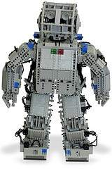
In case of k=6 legs, there are 39916800 possible events. Hence the complexity of robots is directly proportional to the number of legs.

Slide 72
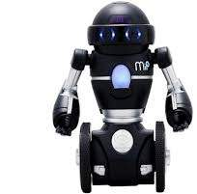
Wheeled Locomotion
It requires fewer number of motors to accomplish a movement.
It is little easy to implement as there are less stability issues in case of more number of wheels. It is power efficient as compared to legged locomotion.
Standard wheel − Rotates around the wheel axle and around the contact
Castor wheel − Rotates around the wheel axle and the offset steering joint.
Swedish 45º and Swedish 90º wheels − Omni-wheel, rotates around the contact point, around the wheel axle, and around the rollers.
Ball or spherical wheel − Omnidirectional wheel, technically difficult to implement.

Slide 73
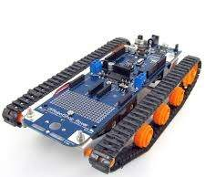
Slip/Skid Locomotion
In this type, the vehicles use tracks as in a tank.
The robot is steered by moving the tracks with different speeds in the same or opposite direction.
It offers stability because of large contact area of track and ground.

Slide 74
Components of a Robot
Robots are constructed with the following −
Power Supply − The robots are powered by batteries, solar power, hydraulic, or pneumatic power sources.
Actuators − They convert energy into movement.
Electric motors (AC/DC) − They are required for rotational movement.
Pneumatic Air Muscles − They contract almost 40% when air is sucked in them.
Muscle Wires − They contract by 5% when electric current is passed through them.
Piezo Motors and Ultrasonic Motors − Best for industrial robots.
Sensors − They provide knowledge of real time information on the task environment. Robots are equipped with vision sensors to be to compute the depth in the environment. A tactile sensor imitates the mechanical properties of touch receptors of human fingertips.

Slide 75
Computer Vision
This is a technology of AI with which the robots can see. The computer vision plays vital role in the domains of safety, security, health, access, and entertainment.
Computer vision automatically extracts, analyzes, and comprehends useful information from a single image or an array of images.
This process involves development of algorithms to accomplish automatic visual comprehension.

Slide 76
Hardware of Computer Vision System
This involves −
Power supply
Image acquisition device such as camera
A processor
A software
A display device for monitoring the system
Accessories such as camera stands, cables, and connectors

Slide 77
Tasks of Computer Vision
OCR − In the domain of computers, Optical Character Reader, a software to convert scanned documents into editable text, which accompanies a scanner.
Face Detection − Many state-of-the-art cameras come with this feature, which enables to read the face and take the picture of that perfect expression. It is used to let a user access the software on correct match.
Object Recognition − They are installed in supermarkets, cameras, high-end cars such as BMW, GM, and Volvo.
Estimating Position − It is estimating position of an object with respect to camera as in position of tumor in human’s body.

Slide 78
Application Domains of Computer Vision
Agriculture
Autonomous vehicles
Biometrics
Character recognition
Forensics, security, and surveillance
Industrial quality inspection
Face recognition
Gesture analysis
Geoscience
Medical imagery
Pollution monitoring
Process control
Remote sensing
Robotics
Transport

Slide 79
Applications of Robotics
The robotics has been instrumental in the various domains such as −
Industries − Robots are used for handling material, cutting, welding, color coating, drilling, polishing, etc.
Military − Autonomous robots can reach inaccessible and hazardous zones during war. A robot named Daksh, developed by Defense Research and Development Organization (DRDO), is in function to destroy life-threatening objects safely.
Medicine − The robots are capable of carrying out hundreds of clinical tests simultaneously, rehabilitating permanently disabled people, and performing complex surgeries such as brain tumors.
Exploration − The robot rock climbers used for space exploration, underwater drones used for ocean exploration are to name a few.
Entertainment − Disney’s engineers have created hundreds of robots for movie making.

Slide 80
Artificial Intelligence - Issues
AI is developing with such an incredible speed, sometimes it seems magical.
There is an opinion among researchers and developers that AI could grow so immensely strong that it would be difficult for humans to control.
Humans developed AI systems by introducing into them every possible intelligence they could, for which the humans themselves now seem threatened.

Slide 81
Threat to Privacy
An AI program that recognizes speech and understands natural language is theoretically capable of understanding each conversation on e-mails and telephones.
Threat to Human Dignity
AI systems have already started replacing the human beings in few industries.
It should not replace people in the sectors where they are holding dignified positions which are pertaining to ethics such as nursing, surgeon, judge, police officer, etc.
Threat to Safety
The self-improving AI systems can become so mighty than humans that could be very difficult to stop from achieving their goals, which may lead to unintended consequences.

